Slide 1
St Alban & St Stephen Catholic Primary School & Nursery Welcome to Year 1
Learning and Growing with God by our Side
September 2024

Slide 2
Our School Prayer
Dear God,
Bless all the children and staff in our school.
Bless all our loving parents, our school community and parishioners.
Let us follow the shining examples of St Alban and St Stephen.
Help us to be the best that we can be and guide us as we stay connected to you and Jesus in all that we do.
As a school, we are learning and growing with God by our side.
Amen.

Slide 3
Our Mission Statement

Slide 5
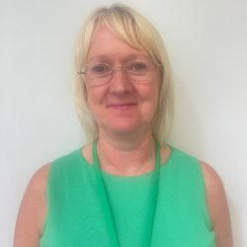
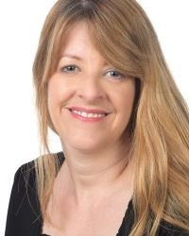
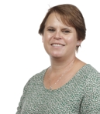
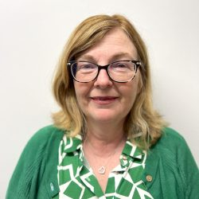
Our Senior Leadership Team
Mrs H. Wilson Executive Headteacher
Ms T. Hackett
Head of School
Mrs C. Smith
Senior Assistant Headteacher & SENDCO
Mrs J. Bates Assistant Headteacher
Mrs C. Smith
Assistant Headteacher
& SENDCO

Slide 6
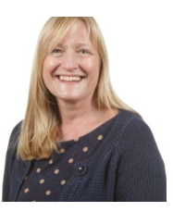
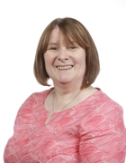
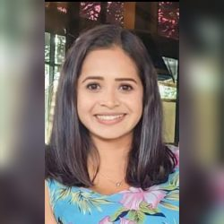
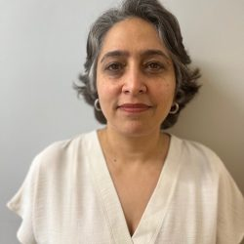
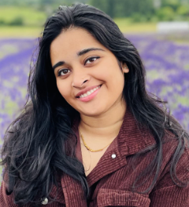
Year 1 Team
Mrs D. Soni
Elm
Teaching Assistant
Mr C. Caramelo
Oak
Class Teacher
Miss Joseph
Elm
Class teacher
Mrs Walker
Elm Teaching Assistant
Monday-Thursday
Mrs Jayamanna
Elm Teaching Assistant
Friday

Slide 7
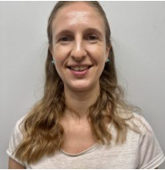
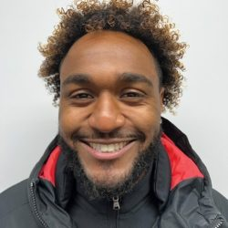
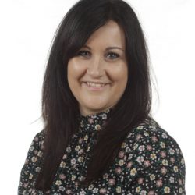
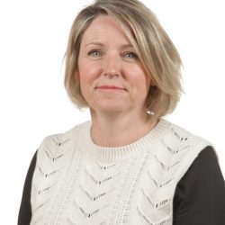
Other Staff Members
P.E and Music (on Wednesday) will be covered by specialist teachers.
Mrs E. Rose
Phase Leader
Key stage 1
Mr S. Wallace
P.E Specialist
Mrs Z. Flatt
Music Specialist
Mrs Rees
Pastoral Mentor
Mrs C. Smith
Assistant Headteacher
& SENDCO

Slide 8
Drop Off and Pick Up
The doors open at 8.45am and close at 8.55am. There is a soft start to the day and when the children arrive, they start their SODA (Start of Day Activity) before lessons begin. Children arriving after 8.55 will be marked late.
Please help your child settle by allowing them to come into the classroom independently.
School finishes at 3.15pm.

Slide 9
Lunches
We encourage parents to discuss school lunches with their child and to book their lunch choices in advance using Arbor.
This ensures that parents help their child to choose a meal they know that they will like and also means a quicker start to the school day .
Red: Meat/Fish option
Green: Vegetarian option
Yellow: Roll or sandwich
Blue: Jacket Potato
Alternatively, your child can bring in their own packed lunch. No glass bottles, fizzy drinks or any food containing nuts are allowed.
Mrs C. Smith
Assistant Headteacher
& SENDCO

Slide 10
Uniform
Please ensure all items of clothing are
CLEARLY MARKED WITH YOUR CHILD’S NAME.
Black school shoes must be worn – no trainers.
Long hair must be tied up with simple black, green or red hair ties.
Jewellery – children may only wear simple stud earrings and a silent watch or Fitbit (no smartwatches allowed). No necklaces, bracelets, charity bands etc are allowed.
A warm, waterproof coat must be provided as children play outside.
Red caps must be worn on sunny days and during trips.
Summer uniform can be worn for the first Autumn half term.

Slide 11
PE Kit
Please ensure all items of clothing are CLEARLY MARKED WITH YOUR CHILD’S NAME.
Our PE days are Wednesday and Friday. Children should wear their P.E. kit to school on P.E. days.
Plain white T shirt (with or without school logos but no other logos)
Red shorts/ black leggings or tracksuit bottoms
Red hoodie with NO DRAWSTRING (plain red or with school logo but no other logos) or school jumper/ cardigan
Plain trainers with non-marking soles
No jewellery should be worn.

Slide 12
R.E.: Come and See
Autumn Term
Domestic Church: Families
Baptism: Belonging
Judaism: Abraham and Moses
Advent/Christmas: Waiting
Spring Term
Local Church: Special people
Eucharist: Meals
Lent/Easter: Change
Summer Term
Pentecost: Holidays and Holydays
Reconciliation: Being Sorry
Sikhism- Guru Nanak
Universal Church: Neighbours
Notes:
Lisa

Slide 13
Reading in Year 1
Each week the children will take part in up to three reading practice sessions. On Thursday, the children will be sent home with the book they have been practising.
Each reading practice session has a clear focus, so that the demands of the session do not overload the children’s working memory.
One book will be sent home each week: Reading practice and Individual reading books (which are fully decodable) and a Library book (which is for sharing with an adult to promote the love of reading).
Our current Library day is every Wednesday!
Please could you return any library books outstanding from Reception.
Notes:
delete

Slide 14
Writing in Year 1
In Year 1, the children will be writing every day, in a range of different contexts.
We still encourage mark making and developing a love for writing through child-initiated learning.
Our school use the Pen Pals handwriting scheme, which is consistent with
the letter formation of Little Wandle.
Notes:
delete

Slide 15
Phonics
Last year we introduced a new scheme ‘Little Wandle’.
Little Wandle provides a completely consistent approach to planning, resources and delivery
How do we teach children phonics?
We teach a phonics lesson every day.
The children learn new sounds each week and have a regular review lessons to
consolidate this learning.
Phonics is learnt in ‘phases’ as a whole class.

Slide 16
Year 1 PSC
The Phonics Screening Test is a statutory requirement from the government which will be conducted in the summer term.
All children in year 1 take the test. In addition, any child in year 2 who did not reach the required level when they took the test in year 1 will take the test again in year 2.
The phonics screening check will take place on a one to one.
It comprises of a list of 40 words that children read one-to-one with a teacher. The list is a combination of both real and made up, non-words which rely purely on using phonics to decode. The non-words are words that have been made up and will be shown with a picture of an imaginary creature to help them.

Slide 17
Maths in Year 1
Daily Maths lesson
In Year 1, we explore Number, Measurement, Geometry (Shapes), Position and Direction.
We aim to develop a strong visual awareness of number and use a lot of practical equipment in the classroom.
Notes:
delete

Slide 18
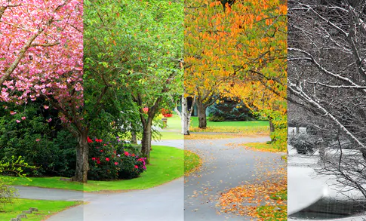
Science in Year 1
Autumn 1: Senses
Autumn 2: Common and wild garden plants and materials
Spring 1: Seasons and materials
Spring 2: Animals and life processes
Summer 1: Seasons and animals
Summer 2: Famous scientists

Slide 19
Other curriculum topics in Year
Computing
Topic (History and Geography)
Art and DT
PSHE
Music
P.E

Slide 20
Home Learning
Each half term, the children will receive a home learning grid. Please complete at least two pieces from the grid, as well as one RE piece.
The grid will be uploaded to Google Classroom and children should submit their work via Google Classroom when they complete a task.
Children should read for a minimum of 10 minutes each evening. Please remember to make a comment in their reading record book.
Every Monday, Phonics and/or Spelling Practice will be added to Google Classroom
for you to practise with your child at home.

Slide 21
How you can help at home
Always encourage and discuss the School’s Golden Rules.
Reading daily with your child. Find opportunities to read spontaneously.
Help your child grow in independence (i.e. getting changed, resolving issues, recognising when they need the toilet and remembering to wash their hands after using the toilet).
Model and teach life skills (i.e. using money, maintaining a healthy diet and lifestyle, gardening, solving problems)
Playing lots of games and encouraging turn taking and counting.
Encouraging an interest of the Topics covered in school and completing home learning tasks to a high quality.

Slide 22
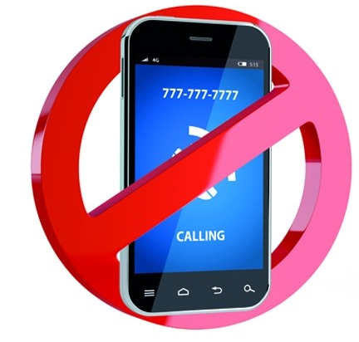
Smartphone-Free School
A significant number of St Albans primary schools have agreed to support the ‘Smartphone-Free Childhood initiative. https://smartphonefreechildhood.co.uk/ https://delaysmartphones.org.uk/
By “smartphones”, we refer to phones that are able to access the internet, as opposed to old-fashioned mobile phones that can only text and make phone calls.
After consulting with staff, parents and governors, we have agreed that at SAS primary-aged pupils should not have smartphones.
Primary-aged pupils should not be on any age-inappropriate social media including WhatsApp, Snapchat, Instagram or TikTok (all have a 13+ age-restriction).

Slide 23
What does this mean for you?
From September 2025, no SAS child will be able to bring a smartphone to school when they walk to and from school. From September 2024, only our current Year 6 pupils who walk to and from school by themselves will be allowed to bring smartphones (as this was already allowed for them last year).
Year 5 and 6 children who walk to and from school by themselves can, if parents wish, bring a tracker or an old-fashioned phone which does not connect to the internet eg a Nokia.
All phones must be handed into the class teacher at the start of the day and will be returned at the end of the day.
We ask parents not to buy their child a smartphone while in primary school. We ask that parents do not allow their child to access age-inappropriate social media and join WhatsApp groups.
Parents on school grounds are not allowed to use mobile phones unless outside the school gates. This is a safeguarding issue. It also sends a message to our children that they are more important than our phones and sets a positive example.

Slide 24
Parent Helpers
The support of parents and other family members is of an enormous benefit to the children and we warmly welcome it.
We already have a team of fantastic parent volunteers who read with children and help in the library every week. If you are interested in becoming a regular volunteer, please notify the office and further information will follow.
(Please note that in line with Hertfordshire County Council, all parents working in school will be asked to apply for police clearance.)
Notes:
Lisa

Slide 25
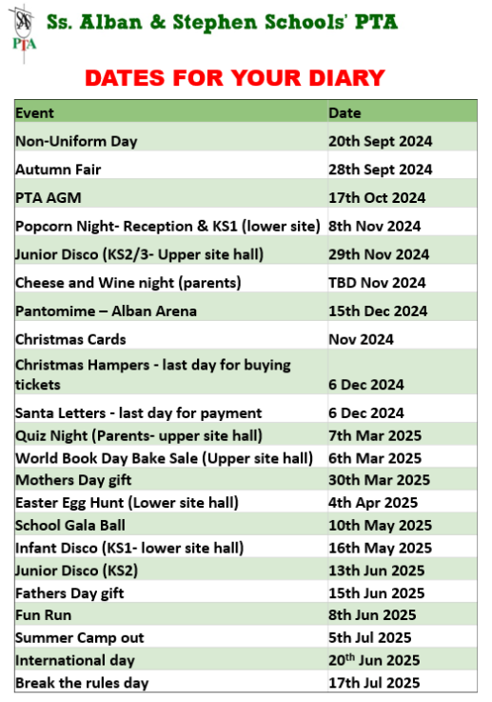

Slide 26
Any Questions?
If you have any further questions, please email the office:
admin@ssas.herts.sch.uk
We will try to get back to you as soon as possible.

Slide 27
Thank you for your support.
We hope that you found this information useful. We are very much looking forward to getting to know your families and children this year.

